Slide 1


Discovering Python
Mrinal Vashisth
PhD Year 2, Computational Pyschometrics, TSU, RF
M.Sc. Human Development: Genetics, Neuroscience and Psychology, TSU, RF
M.S. Applied Mathematics and Information Technology (Systems Biology and Bioinformatics), ITMO, RF
B.Tec. Biotechnology, JNU, RI

Slide 2
Finishing last class loopholes
Fill the metadata spreadsheet for today's class, be prepared to update it later

Slide 3
Let’s read a small article together
https://www.python.org/doc/essays/comparisons/

Slide 4
What we will learn?
Basic operations and variable types in python (not data types)
How to import modules, and take help
Functional paradigm

Slide 5
Programming versus scripting
Scripts are tiny pieces of codes that you can use to perform a task computationally
Programs are collection of scripts that perform a particular function
Two types of programming paradigms
functional programming (example R, also python)
object-oriented programming (example python)

Slide 6
Everything is just memory and operations performed on the memory
A memory can be manipulated as an object called variables
A memory can be processed using functions
A memory can also be manipulated as a class of objects by adding or removing properties from it (next lecture)
C++ libraries
Python libraries
import modules
Use the methods from imported modules on variables or data types (next lecture)

Slide 7
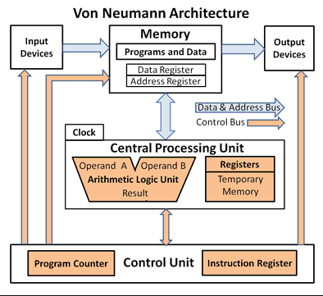
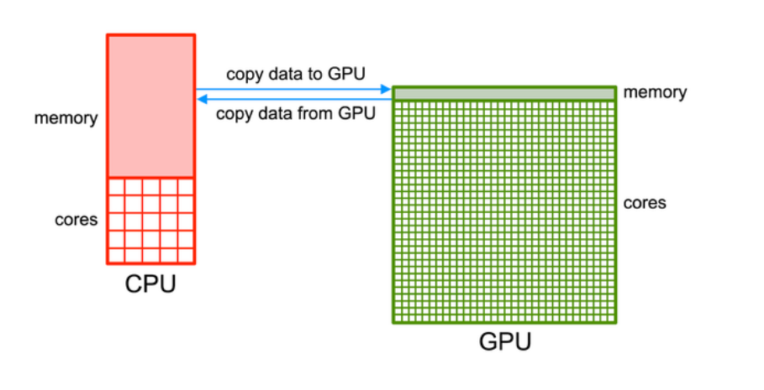

Slide 8
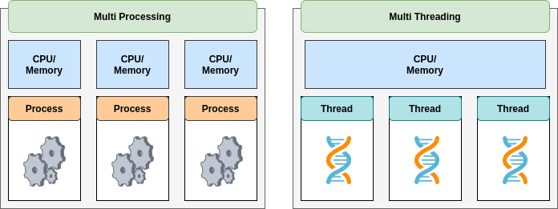
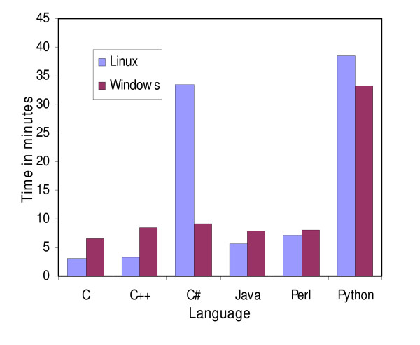
Python does not have multithreading :(
https://www.hpc-carpentry.org/hpc-python/
Fourment, Mathieu & Gillings, Michael. (2008). A comparison of common programming languages used in bioinformatics. BMC bioinformatics. 9. 82. 10.1186/1471-2105-9-82.

Slide 9
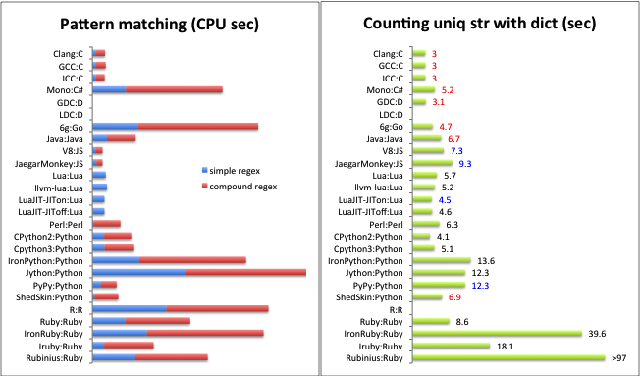

Slide 10

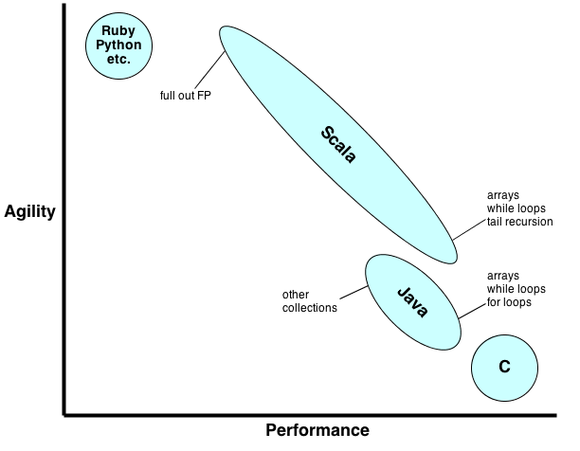

https://developer.nvidia.com/how-to-cuda-python

Slide 11
Practical 1_1
Open jupyter notebook titled 1_1
Follow the steps.
[We will wait until everybody is on the same page]

Slide 12
Assignment
Create a jupyter notebook with examples for all variable types mentioned in the lecture
Take the standard input for two variables from the terminal and write a short code to read two variables num_hours, and payment, run the python file as a code.
(see practical 1 help file)

Slide 13
Projects (Teaser trailer)
There are three types of projects (all data analyses related) - For those who want to pas the couse as data analyst beginners
Do text analysis in python using BERT [Data analysis method]
Develop a small app in DASH [Code management and data visualisation]
Do a genome wide association study in Pyspark [Data analysis method]
The details of the projec will be revealed in session 3.

